Slide 1
Unit 1 INTRODUCTION TO SOFTWARE ENGINEERING
(5 Hrs)
Presented by
Er.Harendra Bikram Shah
Lecturer
Department of BCA
NAST

Slide 2
OUTLINES
Overview of Software Engineering
Definition and characteristics of software.
Software engineering as a discipline and its challenges.
Professional Practices in Software Engineering
Attributes of good software.
Software development life cycle (SDLC) and ethical practices.

Slide 3
Overview of Software Engineering
process of designing, developing, testing, and maintaining software
Principles of Software Engineering
Modularity
Abstraction
Encapsulation
Reusability
Maintenance
Testing
Agile methodologies
8.Continuous Integration & Deployment

Slide 4
Objectives of Software Engineering
Maintainability
Efficiency
Correctness
Reusability
Testability
Reliability
Portability
Adaptability
Interoperability

Slide 5
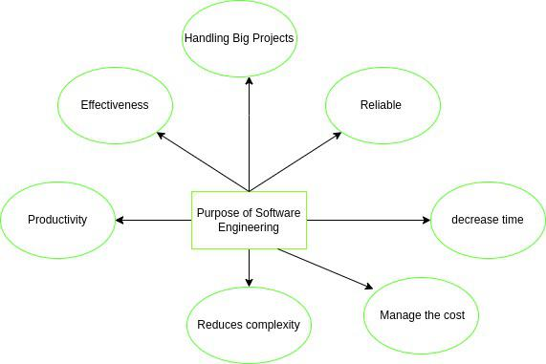
Purpose of Software Engineering

Slide 6
Advantages of Software Engineering
Improved Quality
Increased Productivity
Better Maintainability:
Reduced Costs:
Increased Customer Satisfaction:
Better Team Collaboration:
Better Scalability:
Better Security:

Slide 7
Challenges of Software Engineering
S.No | Challenge | Key Issue
1 | Evolving Tech Landscape | Staying updated with constantly changing tech stacks and tools
2 | Balancing Quality & Speed | Managing the trade-off between fast delivery and high code quality
3 | Complex System Debugging | Diagnosing issues in microservices and distributed systems
4 | Managing Tech Debt | Handling accumulated shortcuts that hinder future development.
5 | Burnout & Stress | Dealing with mental fatigue from high-pressure work environments
6 | Scaling Systems | Designing systems that handle growing user load efficiently
7 | Distributed Teams | Coordinating across time zones and remote communication barriers
8 | Data Privacy & Security | Protecting user data from breaches and ensuring compliance
9 | Legacy Systems | Working with outdated systems that are hard to maintain or upgrade
10 | Adapting to Methodologies | Transitioning between agile, scrum, or waterfall workflows
11 | Code Maintainability | Writing code that's easy to read, maintain, and scale
12 | Version Control Conflicts | Resolving code merge issues in team environments

Slide 8
Job choices in software engineering
SWE (Software Engineer)
SDE ( Software Development Engineer)
Web Developer
Quality Assurance Engineer
Web Designer
Software Test Engineer
Cloud Engineer ·
Front-End Developer
Back-End Developer
DevOps Engineer.
Security Engineer.

Slide 9
Salaries for Careers with a Software Engineering Degree:
Role | Average Salary in USA | Average Salary in Australia | Average Salary in India | Average Salary in Germany
Software Engineering | $124,200 | €67,260 | ₹9,00,000 | €56,787
Backend Dev | $157,602 | €72,354 | ₹9,61,589 | €60,100
Frontend Dev | $113,249 | €69,173 | ₹6,50,000 | €49,380
Full Stack Dev | $123,809 | €72,286 | ₹ 9,20,000 | €51,074
Java Dev | $92,565 | €70,958 | ₹7,36,651 | €50,635
Python Dev | $123,663 | €84,296 | ₹5,50,000 | €55,235

Slide 10
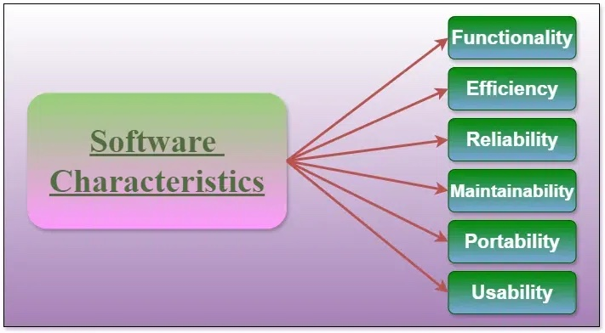
Nature and Characteristics of Software
Collection of computer programs, procedures, rules, and data is software.
Process of designing, developing, testing, and maintaining software is software Engineering.
Components of Software Characteristics

Slide 11
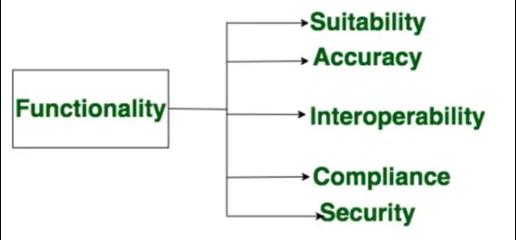
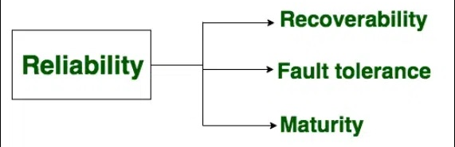
Components of Software Characteristics

Slide 12
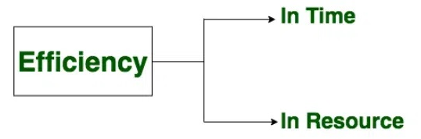
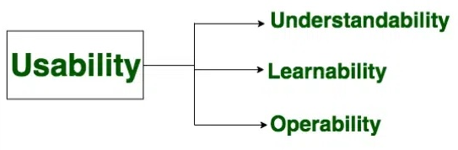
Components of Software Characteristics

Slide 13
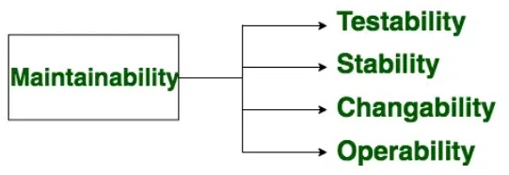
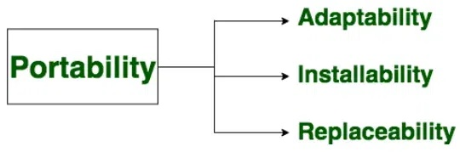
Components of Software Characteristics

Slide 14
Software Engineering versus System Engineering
Aspect | Software Engineering | System Engineering
Focus | Primarily focuses on software development and processes. | Focuses on designing and managing complex systems.
Scope | Narrower scope | Broader scope
Objectives | Develops software applications or systems to meet specific requirements. | Integrates multiple components (hardware, software, processes) to achieve system goals.
Emphasis | Emphasizes software design, coding, testing, and maintenance. | Emphasizes system architecture, integration, and optimization.
Lifecycle | Follows SDLC methodologies. | Involves system lifecycle management from conception to retirement.
Disciplines | Incorporates disciplines like requirements engineering, software design, and quality assurance. | Integrates disciplines such as system architecture, system integration, and system testing.
Skills | Requires strong programming skills, knowledge of algorithms, and software design patterns. | Requires systems thinking, problem-solving skills, and understanding of interdisciplinary concepts.
Examples | Examples:application development, web development, and mobile app development. | Examples :aerospace systems, transportation systems, and healthcare systems.

Slide 15
Software Engineering Ethics and Professional Practice
Goal:
Establish a code of conduct for professional software engineers to make software engineering a beneficial and respected profession.
﻿Joint Effort by lEEE-Computer Society and Association of Computing MachineryACM
Software engineers are those who contribute either by direct participation or by
﻿teaching,
﻿analysing,
﻿Specification generating,
﻿designing,
﻿developing,
﻿certifying,
﻿Maintaining and
﻿testing
of software system

Slide 16
Software Engineering Ethics and Professional Practice
Roles of Engineers
"Professional Software Engineers" include
Practitioners
Educators
Managers
Supervisors
Policy makers
Trainees and Students of the Profession

Slide 17
Software Engineering Ethics and Professional Practice
1. PUBLIC
Software engineers shall act consistently with the public interest
2. CLIENT AND EMPLOYER
Software engineers shall act in a manner that is in the best interests of their client and employer, consistent with the public interest
3.PRODUCT
Software engineers shall ensure that their products and related modifications meet the highest professional standards possible
4. JUDGMENT
﻿Software engineers shall maintain integrity and independence in their professional judgment
5. MANAGEMENT
﻿Software engineering managers and leaders shall subscribe to and promote an ethical approach to the management of software development and maintenance
6. PROFESSION
﻿Software engineers shall advance the integrity and reputation of the profession consistent with the public interest
7. COLLEAGUES
﻿﻿Software engineers shall be fair to and supportive of their colleagues
8. SELF
﻿Software engineers shall participate in lifelong learning regarding the practice of their profession and shall promote an ethical approach to the practice of the profession

Slide 18
Software Engineering Ethics
Professional Practices:
Continuous Learning:
Clear Communication:
Accountability: .
Teamwork:
Adherence to Standards:
Ethical Challenges in Software Engineering:
Privacy and Security:
Bias and Discrimination:
Environmental Impact:
Intellectual Property:
Social Responsibility:

Slide 19
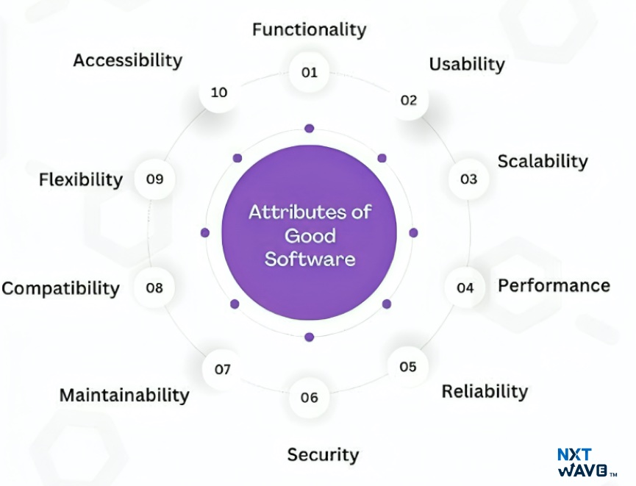
Attributes of Good Software

Slide 20
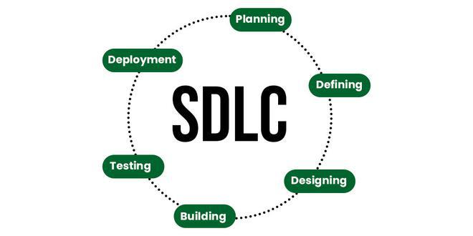
Software Development Life Cycle[SDLC]
It refers to the process of designing, creating, deploying, and maintaining software applications or systems.
It involves a systematic approach to building software that meets specific requirements and objectives.

Slide 21
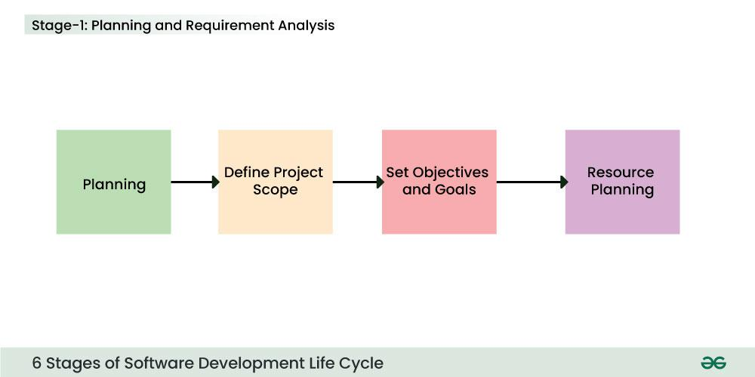

Slide 22
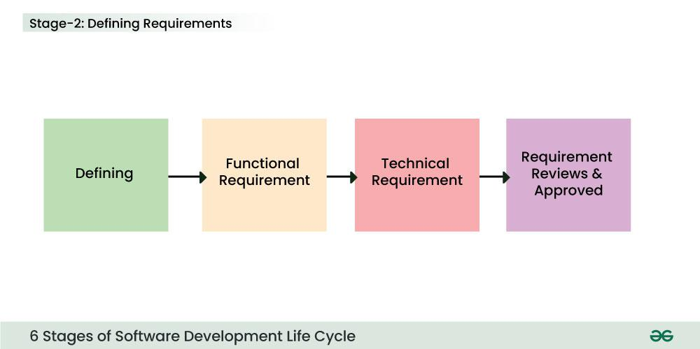

Slide 23
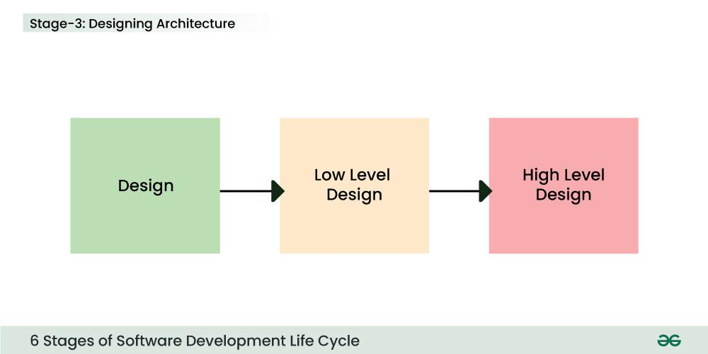

Slide 24
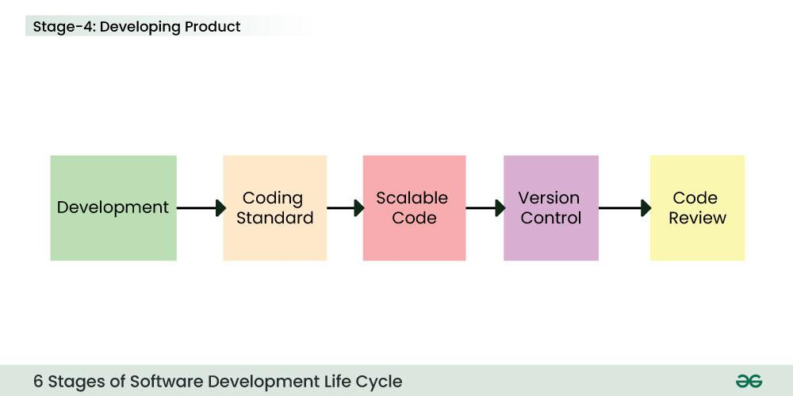

Slide 25
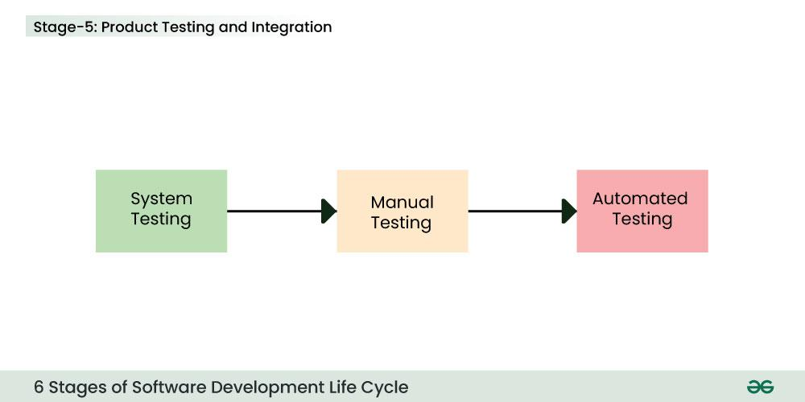

Slide 26
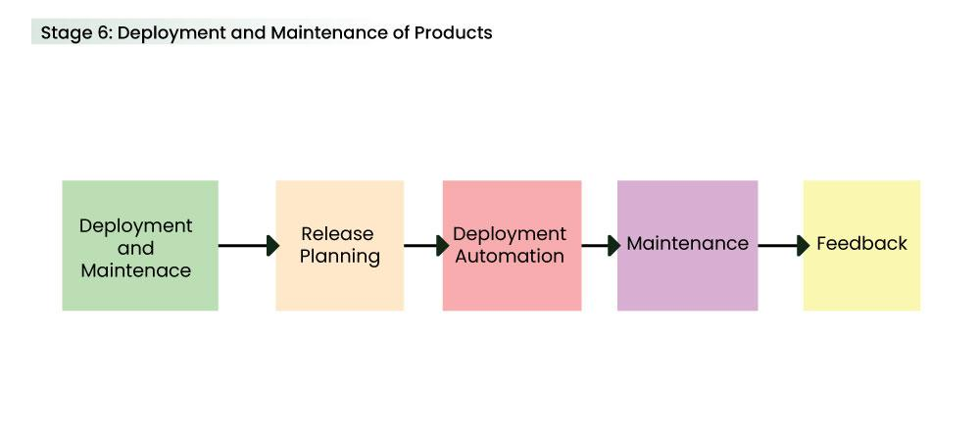

Slide 27
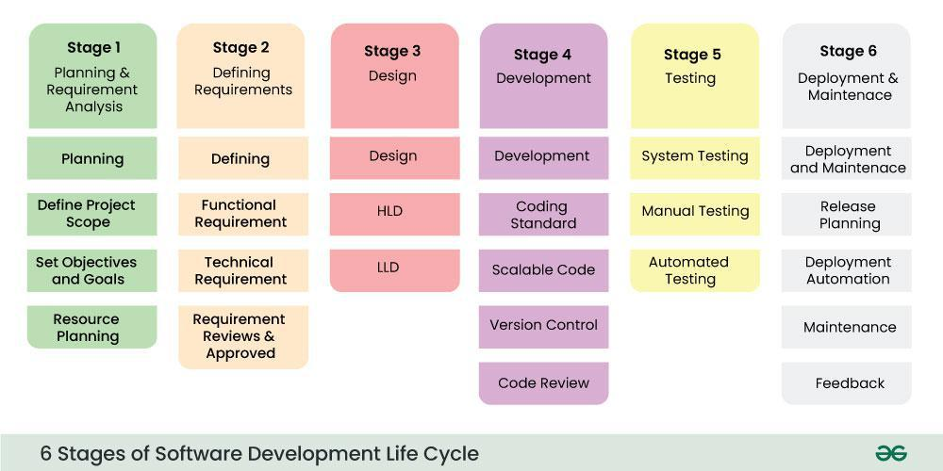
SDLC

Slide 28
End of The Unit

Slide 29
THANK YOU

